Slide 1


Big Data Technology (CS523)
Professor Mrudula Mukadam
Student Munkhbayar Enkhbaatar (613467)

Slide 2
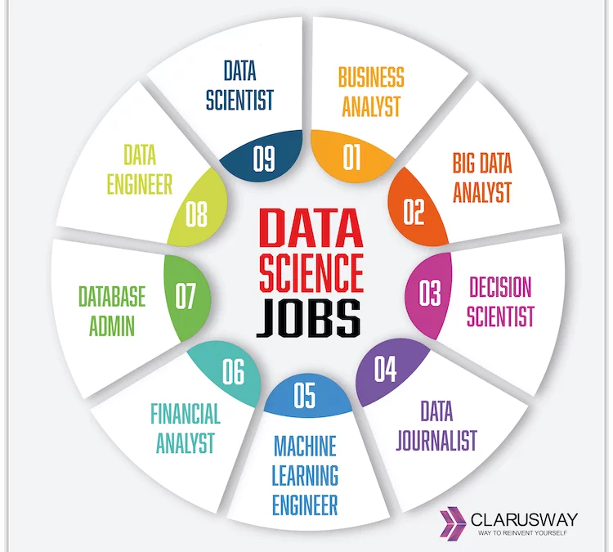
Project: DataScience Job Salaries
Gets the top-rated jobs in the Data Science domain data and stores into the Hbase using Kafka and Spark Streaming

Slide 3




Data Flow Diagram
Data
Collect
Process
Store

Slide 4
Environment
Cloudera Quickstart VM 5.13.0
Java 8
Hadoop 2.6.0
Spark 2.4.3
HBase 1.2.0
Kafka 0.10.2.2

Slide 5
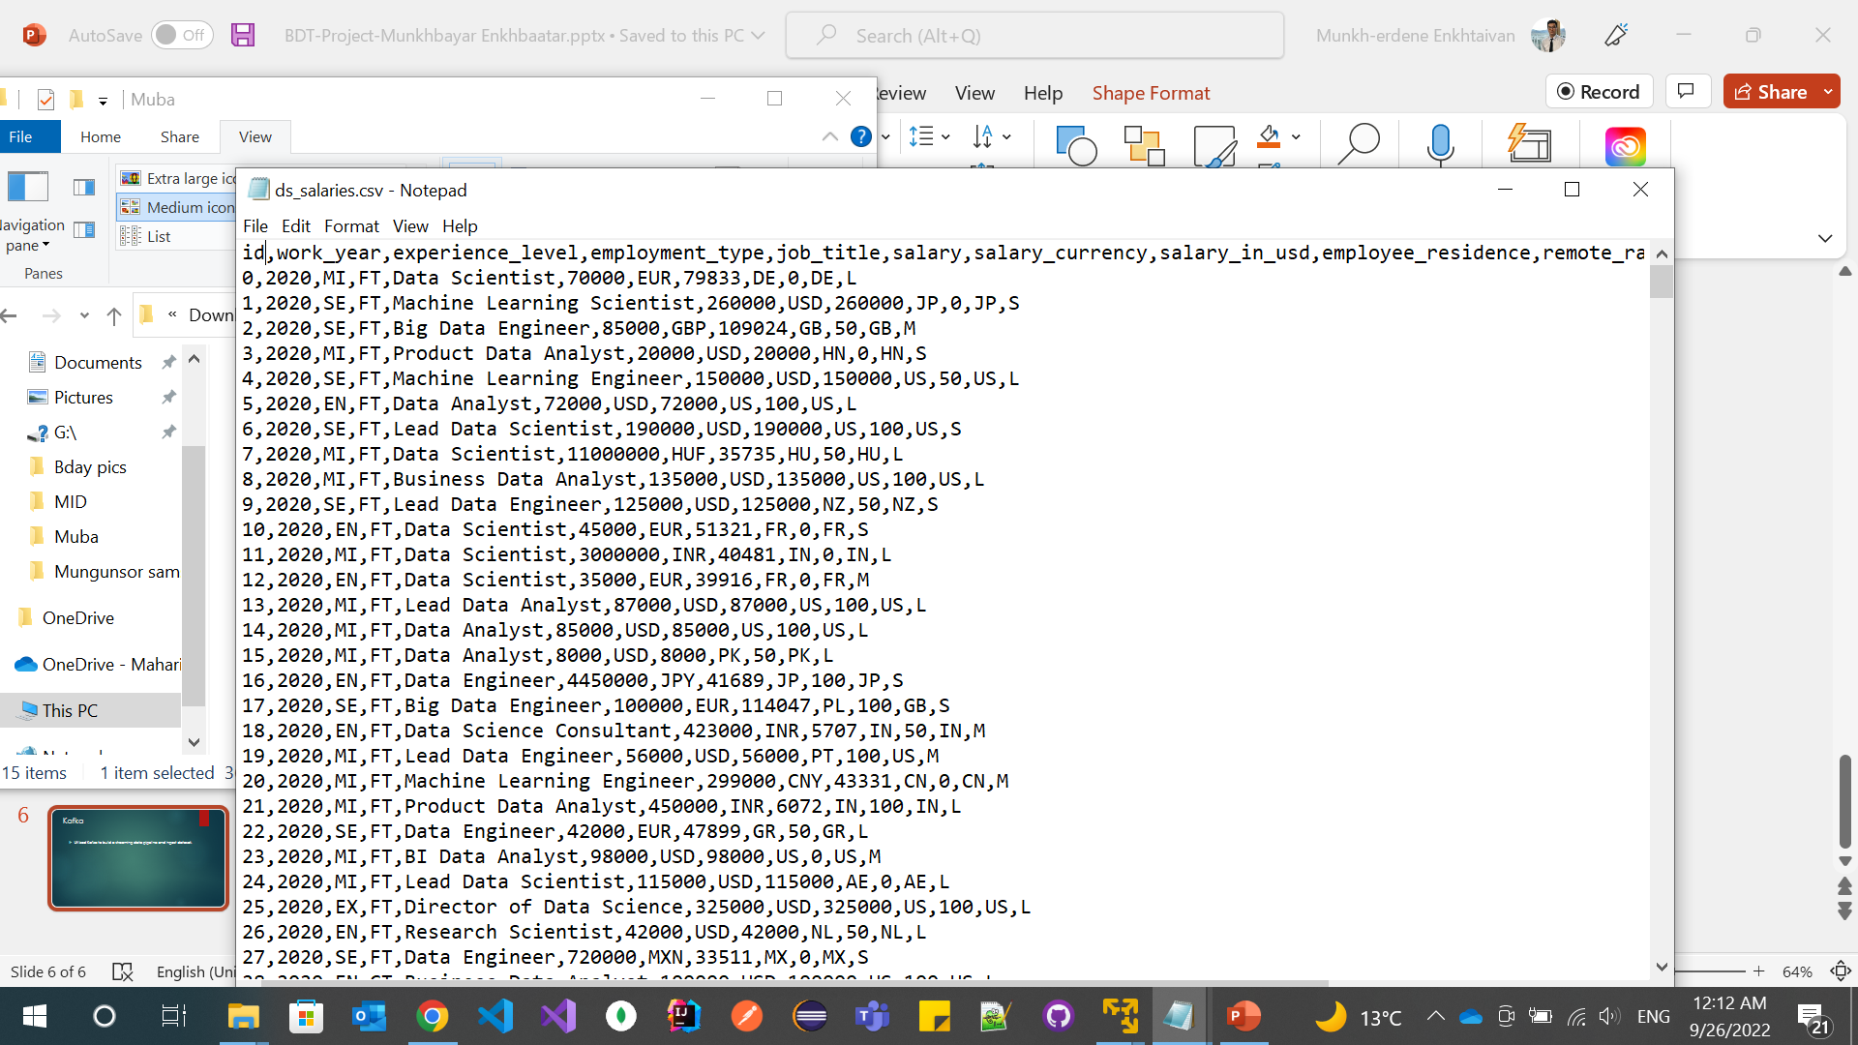
Data
DS salaries dataset contains the last 3 years of salary information of DS jobs like data scientist, data analyst, machine learning engineer, etc.
Dataset type: CSV file
Resource: www.kaggle.com

Slide 6
Kafka
Creating topic
> bin/kafka-topics.sh --create --zookeeper localhost:2181 \
--replication-factor 1 --partitions 1 --topic test-topic
Utilized Kafka to build a streaming data pipeline and ingest dataset.
Producing data from csv
>tail -n +2 ~/workspace/BdtFinalProject/input/ds_salaries.csv \
| bin/kafka-console-producer.sh --broker-list localhost:9092 \
--topic test-topic

Slide 7
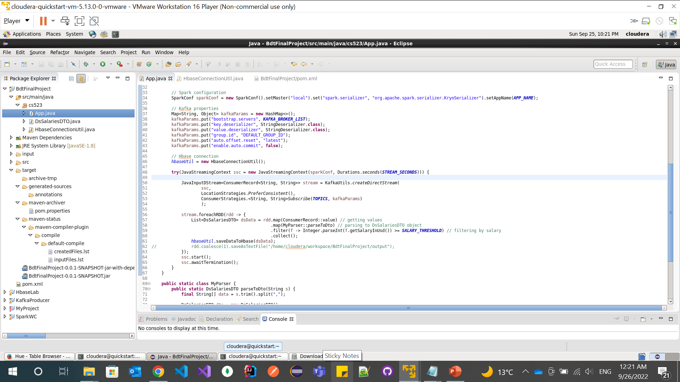
Spark Streaming
Gets the incoming streaming data, creates the table to store data, processes it, and pushes it to the database.

Slide 8
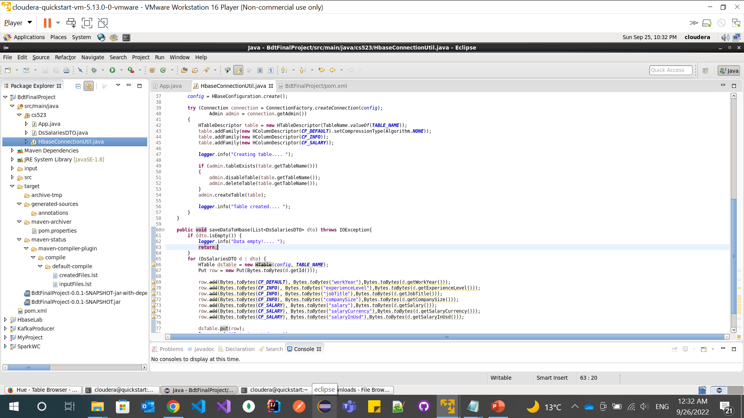
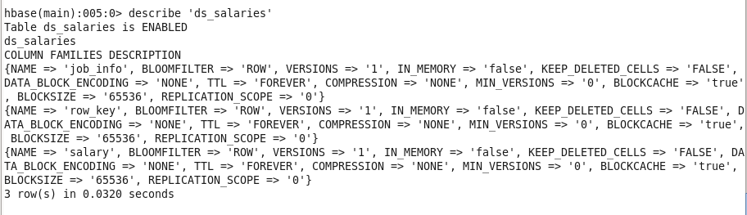
HBase
Stores the data.

Slide 9

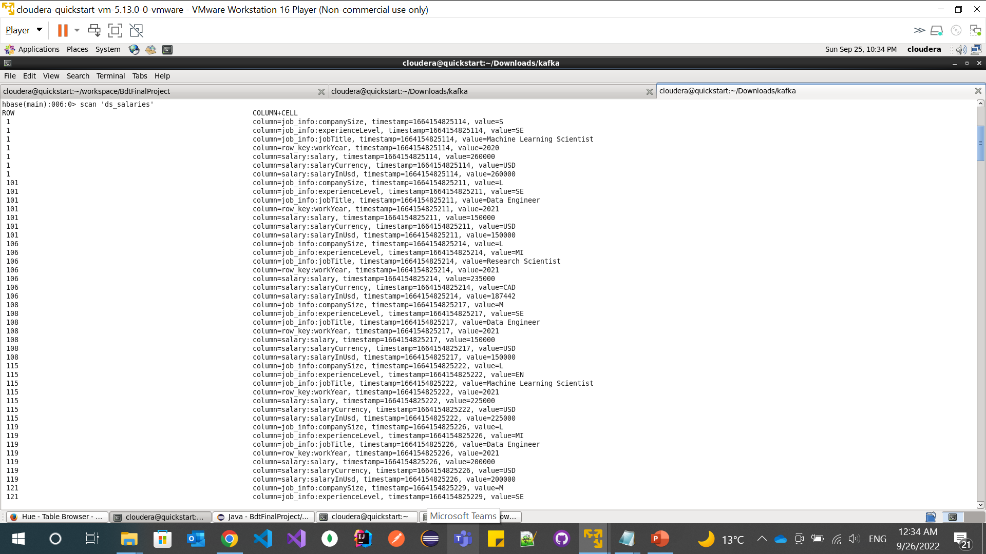



Output

Slide 10

Thank you
References:
BDT lectures
Kafka
Spark Streaming
Project’s GitHub URL

